Slide 1
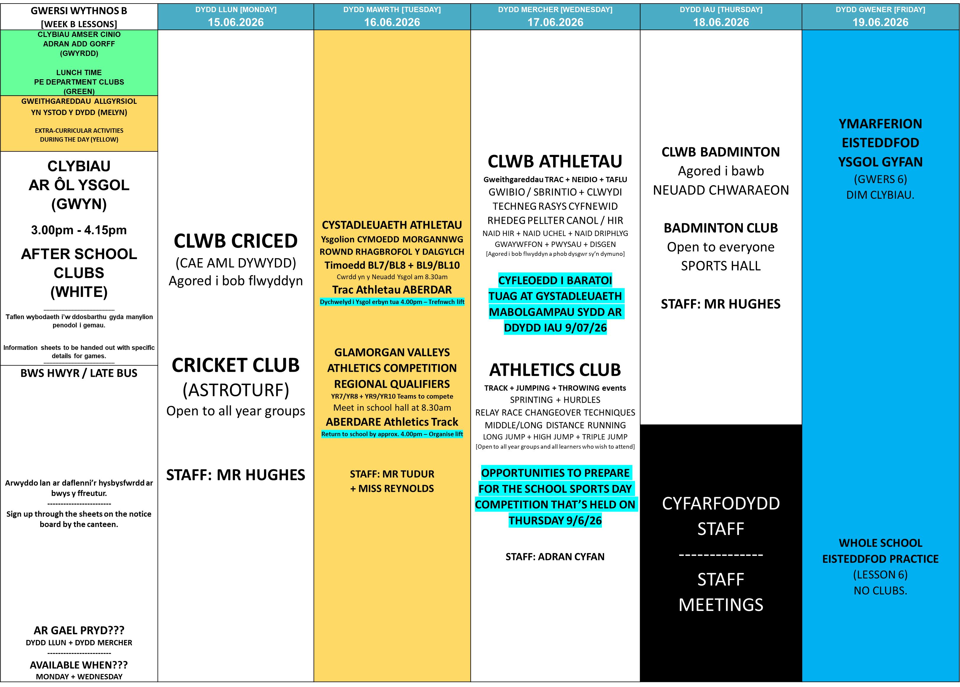


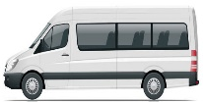



Slide 2


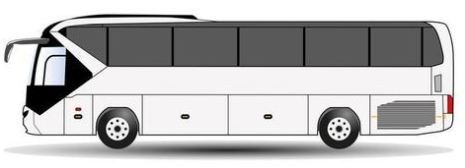
Gadael safle’r ysgol tua 4.15pm / Leaves school site approximately 4.15pm
DYDD LLUN / MONDAY:
MAESTEG
NANTYFFYLLON
CAERAU
DYDD LLUN / MONDAY:
SHWT
BETTWS
PONTYCYMER
WILDMILL
BRACKLA
DYDD MERCHER / WEDNESDAY:
TONDU
ABERKENFIG
PYLE
CORNELLY
PORTHCAWL
Arwyddo lan ar daflenni’r hysbysfwrdd ar bwys y ffreutur
Sign up through the sheets on the notice board by the canteen

